Slide 1
Future Direction of Tourism Policy Studies
TERAMAE Shuichi Phd
President of Human Logistics labotary
Professor of Teikyoheisei University

Slide 2
The change of the purpose of Tourism Policy in Japan
In the legal system, at first, the purpose of Tourism Policy in Japan was to earn foreign exchange.
But in new Tourism Nation Promotion Basic Law (2006) the purpose has changed to National and Regional pride.

Slide 3
Tourism Policy of ex Imperial Japan

Slide 4
Japan's situation in 1930 before and after
1905 Russo-Japanese War End
1915 First World War
1922 Washington Naval Disarmament Treaty
1923 Great Metropolitan Area Earthquake
1925 Universal suffrage
1929 National Treasure Preservation Act
World depression
1930 Board of Tourist Industry、 Trade Department
Kyoto City Tourism Division
London Naval Disarmament Treaty
Export release of gold
1931 National Parks Law Gold export re-ban
Manchurian Incident

Slide 5
Board of Tourist Industry (1930)
In English “Board of Tourist Industry” not “International tourism Bureau”
Not using “Tourism”
Not using “International”
In Japanese, “international” was used by Minister of railroad’s strong desire
The original meaning of “kanko” was changed from “outbound” to “inbound”

Slide 6
Deployment of postwar domestic tourism administration
Ministry of Education
Recreation and sports administration
Cultural properties protection administration （for foreigner）
Integration
Social tourism
welfare administration
Inn and restaurant
administration
The lodgings for the nation
holiday village for the nation
Comprehensive Resort Areas Development Law
Environmental administration
Hot spring administration（for foreigner）
National park aministration
（for foreigner）
For Japanese
Integration
International Tourist Hotel Improvement Act
（for foreigner）
The popularization of the International Tourist Ryokan
International Tourism administration
The trip mediation work act （for foreigner）
Travel agency act

Slide 7
ーーー to earn foreign exchange ーーー
1930 Board of Tourist Industry
－－－World War Ⅱ－－－
1949 International Tourist Hotel Preparing Ａｃｔ
1963 Tourism Basic Law
1964 Tokyo Olympic
ーーー National and Regional pride ーーー
2006 Tourism Nation Promotion Basic Law

Slide 8
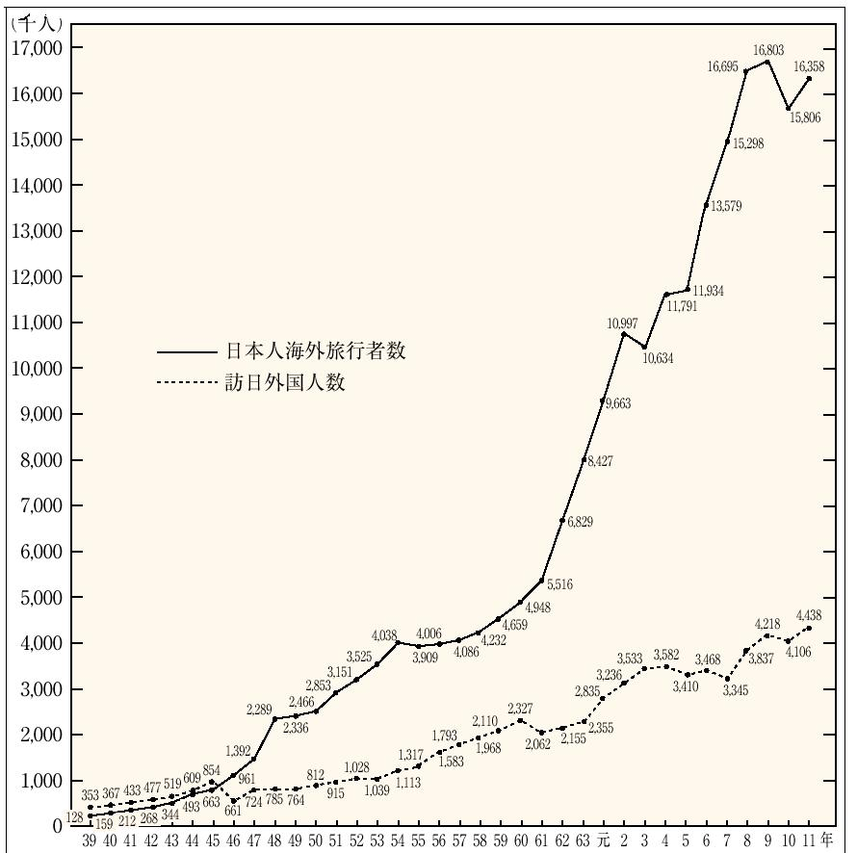
TEN MILLION PROGRAM
（Doubling the number of Japaneseabroad）
5
million
outbound
1963
First year of outbound
5
million
inbound
1964
Tokyo Olympic
1971
Outboud exceeded inbound

Slide 9
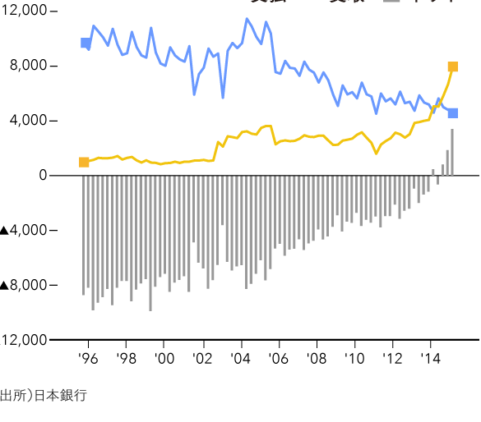
International travel balance of payments
100Million yen
Payment
Acceptance
Balance difference

Slide 10
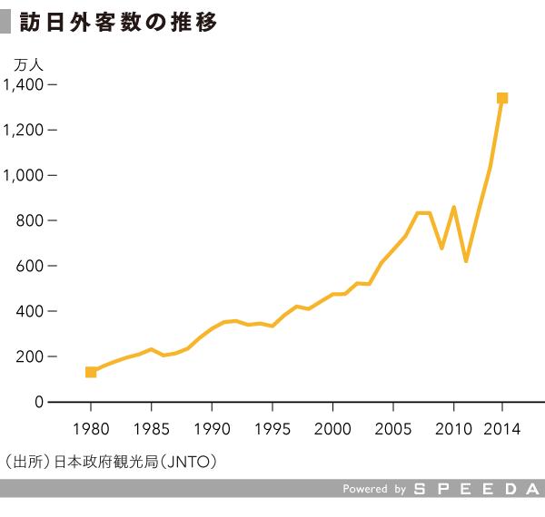
The number of foreign visitors
weaker yen
10 thousand
Economic growth of neighboring countrie

Slide 11
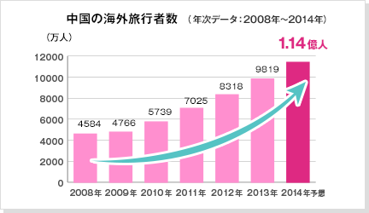
Chinese overseas travelers number
50000
10 thousand
person
11400
11400
2019

Slide 12
Tourism resources system ～ What mind and regulations produce ～

Slide 15
Basic Law defines "tourism resources“ Country is considered as a target for achieving the "protection, training and development."
「 Cultural heritage (historic sites, scenic beauty, natural monument, etc.) 」
「 The outstanding natural landscape areas 」
「 Onsen (Japan unique) 」
「 Other, tourism resources related to culture, industry, etc. 」 (Basket clause)
ーAdded by Tourism Nation Promotion Basic Lawー
「 Historical landscape 」
「 Good landscape 」

Slide 17
Lexical “health and recreation”
For western people
Westernization
Relativization
Popularization
Public stance
Clear differences in lifestyle
(at that time)
Development and deployment of welfare administration
For Japanese
people
Real intention
The inner main outside follow

Slide 18
If the translation of concept “Tourism” was lexical "sightseeing", deployment of Japanese tourism administration might have changed.

Slide 19
Phenomenon of relative between the unordinary and ordinary in tourism related legislation

Slide 20
Changes in the concept of tourism in tourism policy

Slide 21
Human Logistics
People Logistics

Slide 22
Fusion of tourism and public transport
Uber
airbnb

Slide 23
Conventional package tour
Single Pack can be in Japan
Pack harge
Travel
Destination
HOME
In TRIP
運送又は宿泊のサービス
（ホテルバス、コンドミニアム等も可）
法制度ではなく
約款上の仕組み
旅程保証責任
特別補償責任

Slide 24
マルチ・パッケージ・ツアー
鉄道定期券類似の
タクシー定期券への発展
月極定額料金
自宅
旅行先
在宅中の補償の取扱
旅程保証責任
使い放題
特別補償責任

Slide 25
夢の３ＰＨＬ商品（人生保障旅行）
月極定額料金
観光活動
居所
宿所
「人流」保証責任 旅程概念の終焉
「特別」補償責任

Slide 26
Wearable
Through location information by smart-phone, it is made to allow the big data analysis of human logistics information. Moreover, through progress in wearable devices, it would become to be possible to grasp the body and the brain reaction against tourist resource in real time. The deployment of the future of regional tourism policy research, with the help of a wearable device, or would not exist at that to discover the tourist culture gene.

Slide 27
Human attributes・The data on the move
（specified large number）
The discovery of Tourism- Culture gene
Science of
the evaluation
of tourism resources
Use of wearable device
Reaction data to the tourism resources
（ Objective response information ）

Slide 28
実験結果
https://youtu.be/Sq4M3nvX6Io

